Slide 1
OnePose : One-Shot Object Pose Estimation without CAD Models
Stage 1: Graphical Abstract & Initial Understanding
Team 3:
Akhilesh Katari
Raghavendra Huliyurdurga Mallesha

Slide 2
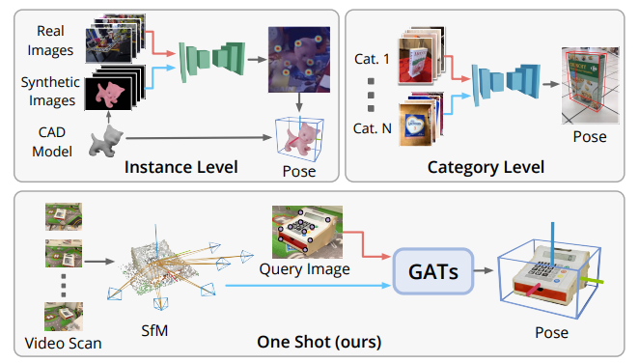
Introduction
Traditionally, there have been two main ways to do this: Instance-level and Category-level.
Instance-level methods require a precise 3D CAD model for every single object.
Category-level methods try to solve this by training a neural network.
9/12/22
Footer Space
(Slide No.) 2

Slide 3
New Approach OnePose
The authors of OnePose propose a new 'one-shot' approach that avoids these limitations.
The idea is simple: instead of a CAD model or extensive training, we just take a short video of the object with your phone.
Structure from Motion (SfM)

Slide 4
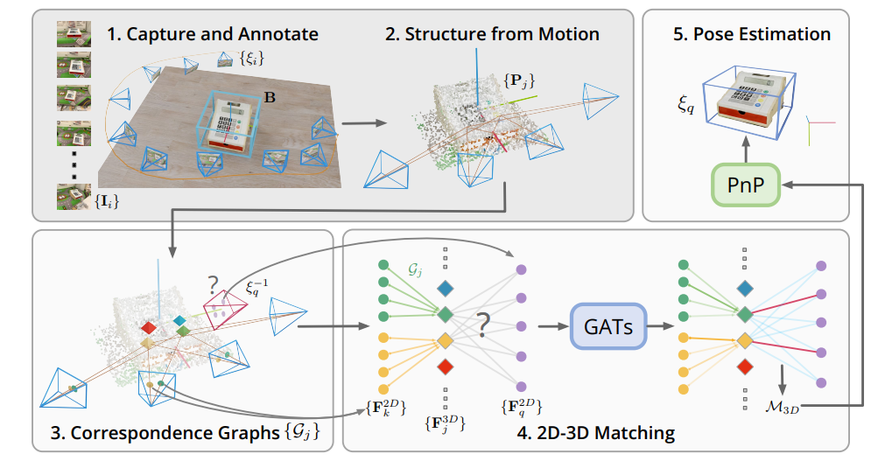
Method : The OnePose Pipeline in Detail
Mapping (Offline)
Localization (Online)
2D-3D Matching
Pose Estimation
9/12/22
Footer Space
(Slide No.) 4

Slide 5
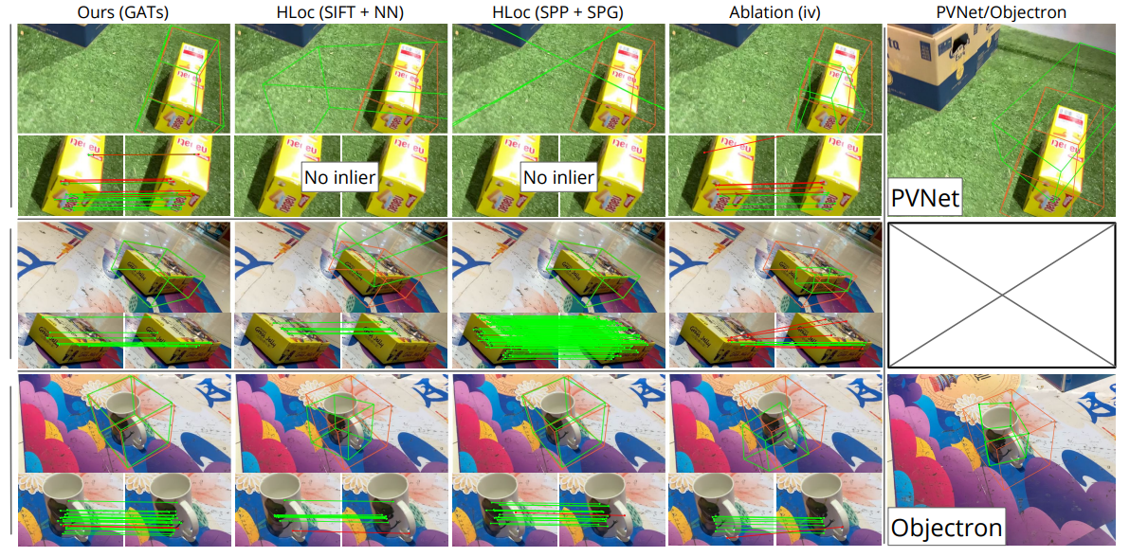
Results
9/12/22
Footer Space
(Slide No.) 5

Slide 6
Summary
OnePose is a novel method for estimating the 6D pose (position and orientation) of any object without needing a 3D CAD model.
Traditional methods require CAD model for each specific object (instance-level) or extensive training on many examples within a category (category-level).
OnePose by using a "one-shot" approach. It only requires a brief video scan of the object, which is then used to generate a 3D model through Structure from Motion (SfM).
When a new image of the object is presented, a specialized Graph Attention Network (GAT) is used to match features from the 2D image to the 3D model.
This 2D-3D matching allows for the quick and accurate calculation of the object's pose, making it suitable for real-time applications like augmented reality. give this like human explaining
9/12/22
Footer Space
(Slide No.) 6

